Slide 1




Learned Query Optimizer: What is New and What is Next
Tutorial
Rong Zhu, Lianggui Weng, Bolin Ding, Jingren Zhou
Institute for Intelligent Computing
Alibaba Group
TONGYI

Slide 2
Part 4: Applications and Deployment
Prototype Applications
Learned cost model for SCOPE in Microsoft
Learn to steer SCOPE in Microsoft
OpenGauss
PilotScope: A Middleware System for Deployment

Slide 3
Part 4: Applications and Deployment
Prototype Applications
Learned cost model for SCOPE in Microsoft
Learn to steer SCOPE in Microsoft
OpenGauss
PilotScope: A Middleware System for Deployment

Slide 4
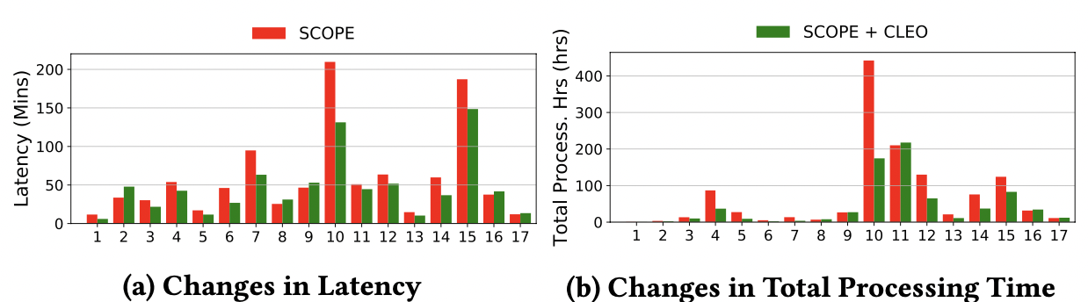
Learned Cost Model in SCOPE
SCOPE: the big data system for data analytics in Microsoft
Learned cost models could improve plan quality of production jobs
Figure from [Cost Models for Big Data Query Processing: Learning, Retrofitting, and Our Findings, SIGMOD 2020]

Slide 5
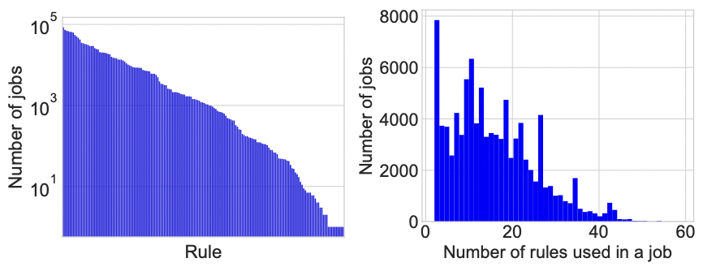
SCOPE and Its Hints
SCOPE: tuning different hints
256 hints in total, 100-150 hints are used frequently
Typically 10 − 20 hints are used in a single job
Analyze to discover suitable hint set to steer SCOPE
Figure from [Steering Query Optimizers: A Practical Take on Big Data Workloads, SIGMOD 2021]

Slide 6
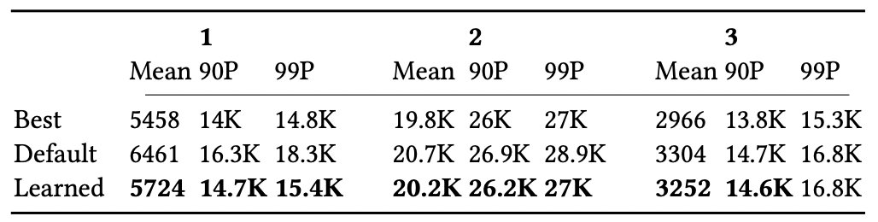
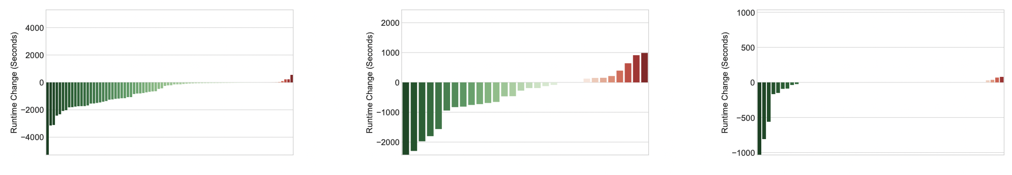
Learn to Steer SCOPE
Online deployment: large improvements, small regressions
Figure and Table from [Steering Query Optimizers: A Practical Take on Big Data Workloads, SIGMOD 2021]

Slide 7
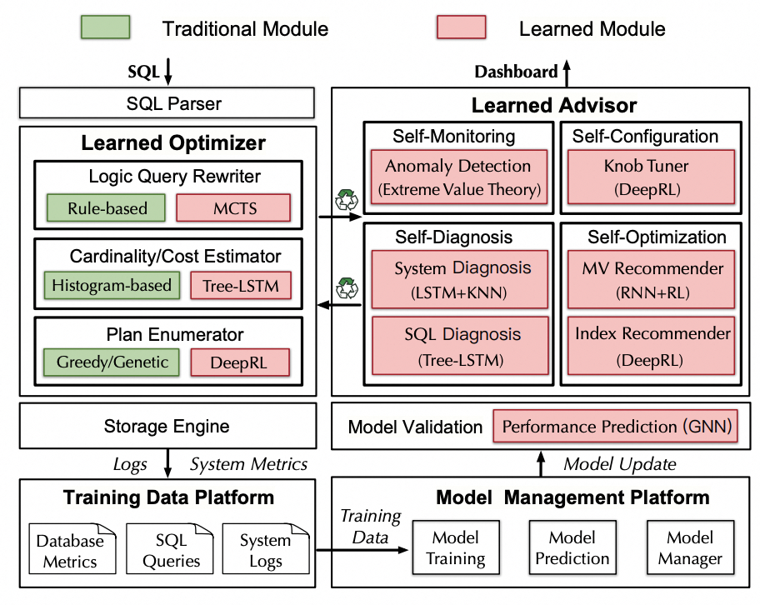
OpenGauss: Automatic DB
Multiple learned components
are deployed into GaussDB
Query rewriter
Cardinality/Cost Estimator
Plan Enumerator
…
Traditional Methods as backups
Difficult to extend to other AI4DB methods and DB systems
Figure from [openGauss: An Autonomous Database System, VLDB 2021]

Slide 8
Part 4: Applications and Deployment
Prototype Applications
Learned cost model for SCOPE in Microsoft
Learn to steer SCOPE
OpenGauss
PilotScope: A Middleware System for Deployment

Slide 9




PilotScope: Motivations
AI4DB algorithms are developing very fast ……
A fundamental problem is still not well studied
Could they actual contribute to real world DBMS?
If so, to what extent?
If not, why not?
This could only be answered by actual deployment (gold standard)
Examine in real systems, on real data, report real performance
The pros & cons of each method
……
→ guide future research towards the right direction
Cost Model
Query Optimizer
. . .
Knob Tuning
Index
Recommendation
(PilotScope) PilotScope: steering databases with ML drivers , VLDB 2024

Slide 10
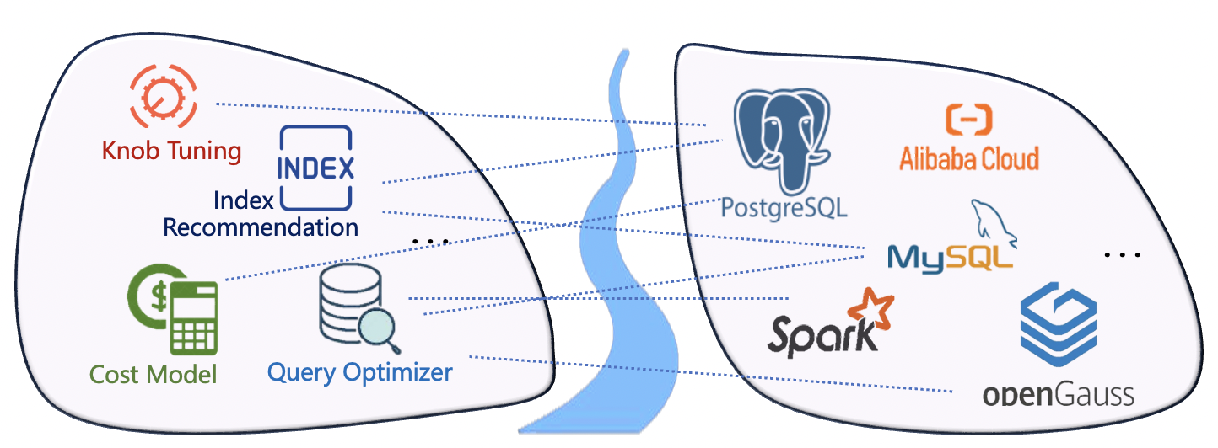
PilotScope: Existing Solutions
Deploying specific algorithm into specific DB
Learned query optimizer/cost model → SCOPE
Knob tuning/query optimizer → openGauss
Workload forecasting/behavior modeling → NoisePage
……
. . .
Notes:
Term问题

Slide 11
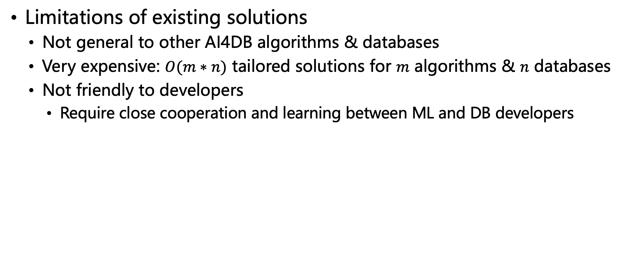
PilotScope: Existing Solutions
Limitations of existing solutions
Not general to other AI4DB algorithms & databases
Very expensive: $O(m∗n)$ tailored solutions for $m$ algorithms & $n$ databases
Not friendly to developers
Require close cooperation and learning between ML and DB developers
. . .
. . .

Slide 12
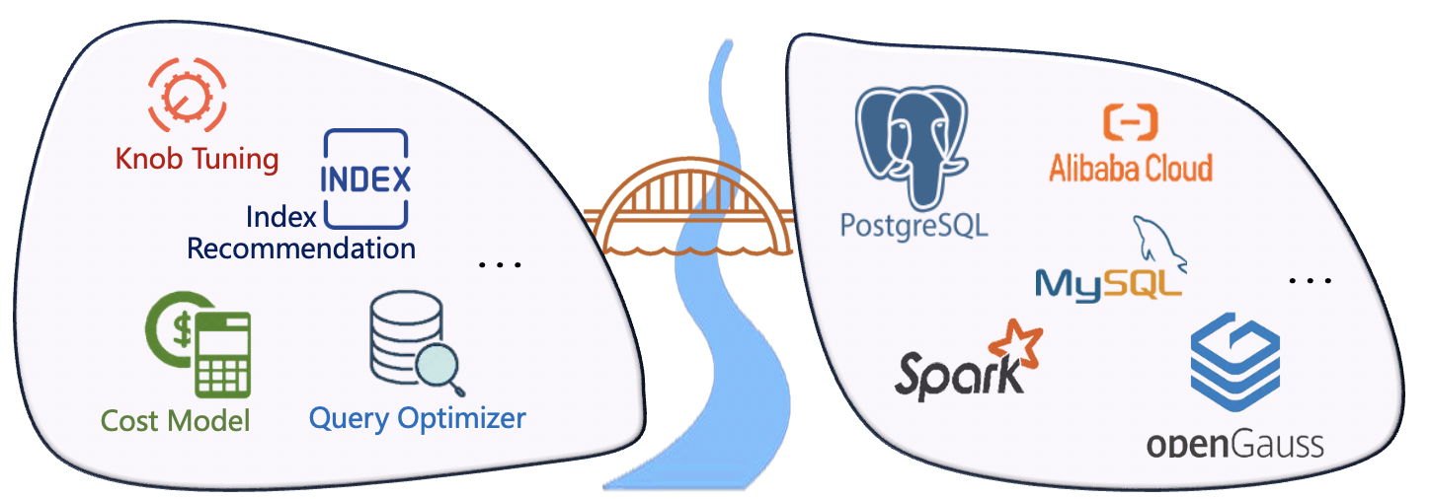
PilotScope: Our Principle
What we desire of the AI4DB deployment?
One system generally appliable for multiple algorithms & databases
General to algorithm: support different AI4DB tasks
General to system: the same ML program could run on different systems
Easy to extensible to other AI4DB algorithms/database systems

Slide 13

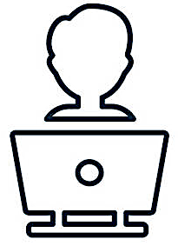
PilotScope: Our Principle
What we desire of the AI4DB deployment?
ML & DB developers could work independently
Developers could focus on writing their own programs
Not need to know details in other side
ML Developer
DB Developer

Slide 14

PilotScope: Our Principle
What we desire of the AI4DB deployment?
The minimal impact to the native databases
Low risks to DB
Low learning cost to databases users
DB User
ML Developer
DB Developer
Notes:
改成一句话

Slide 15
PilotScope: Challenges
A desirable deployment system is very challenging
ML and DB have very different paradigms: language, dependency, …
AI4DB algorithms are very diversified
An AI4DB task usually involves a long pipeline on data interaction
Database systems are very complex
Difficult and risky to modify the codebase
……

Slide 16
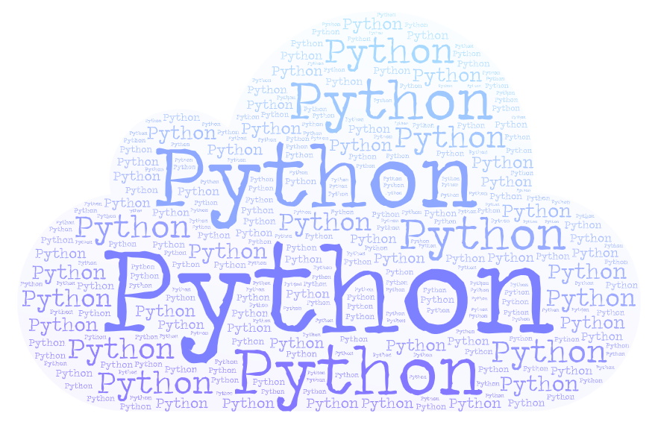

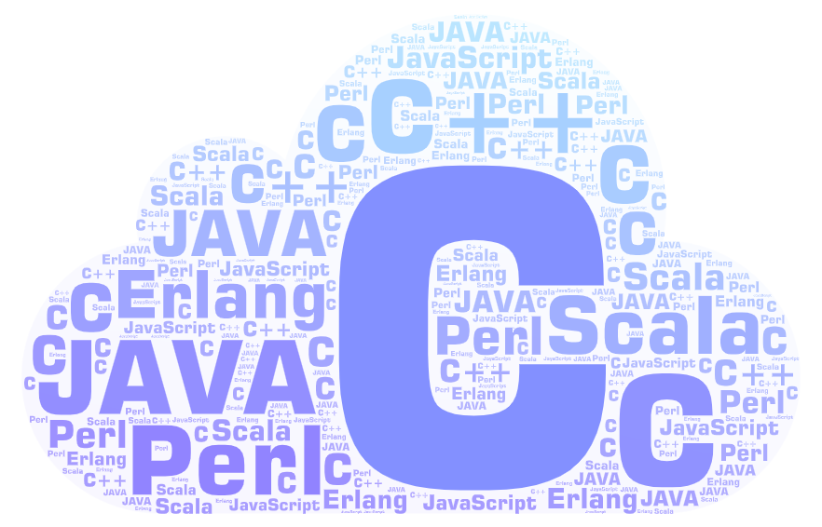
PilotScope: Framework
How to bridge the gap between AI and DB?
Data Exchange, Enforce Actions…
Implement and Execute
Unified Interface on Data Interaction
ML Researcher or Developer
DB Developer

Slide 17



PilotScope: System Architecture
Written by ML developers, not care about DB details
Implement by DB developers as patches
PilotScope
AI4DB Drivers
Database System X
Database Users
Driver A
Driver B
AI4DB Algorithm
AI4DB Algorithm
Implementations of DB Interactor on X
Database Tasks
Console
…
Knob Tuning
Index
Recommendation
…
$ connect to database X
$ login into database X
$ start driver A
… …
$ select * from table T where T.c > 1
… …
ML Models
ML Models
Cardinality
Estimation
Query Optimizer
ML Runtime Environment
Interface of DB Interactor
Injection Interface
Data Collection
…
Database System Y
Third-party Dependencies and Libraries
Implementations of DB Interactor on Y
Operators
Database Tasks
Push
Pull
Accessed by DB users, operate database as usual
Hinder the details of different databases

Slide 18
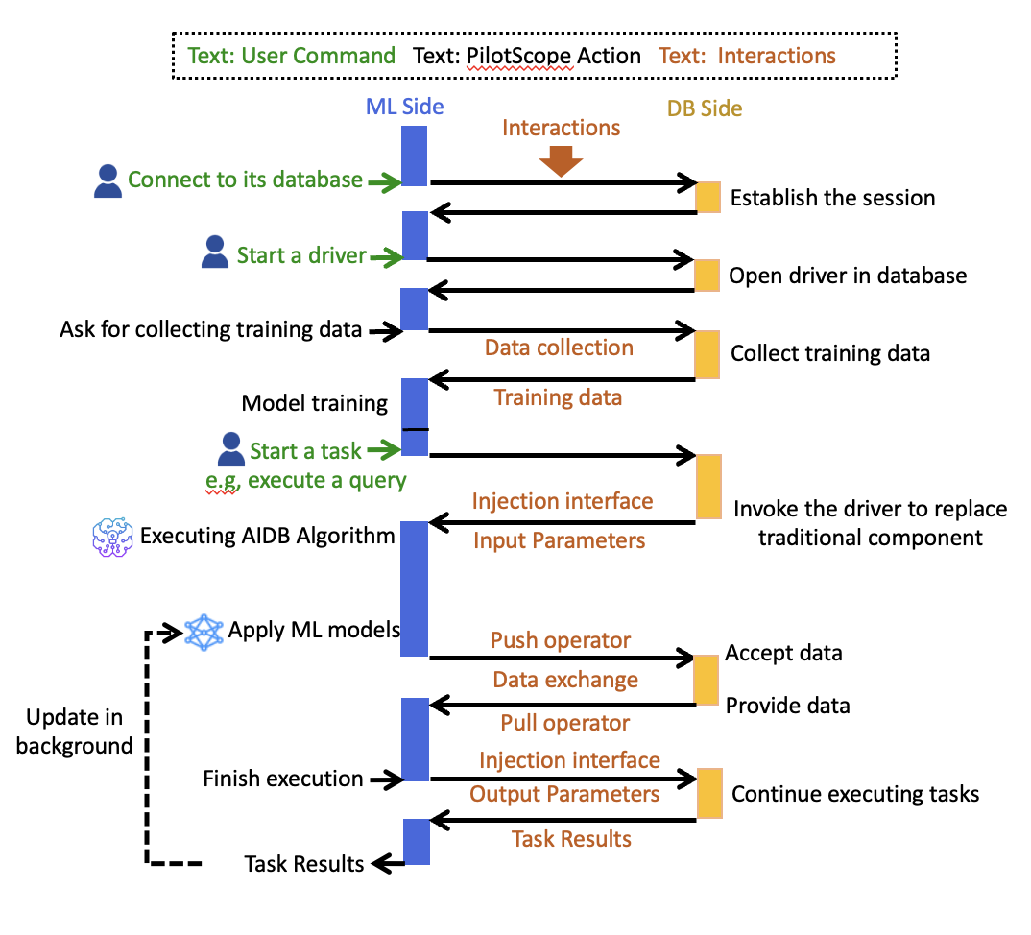
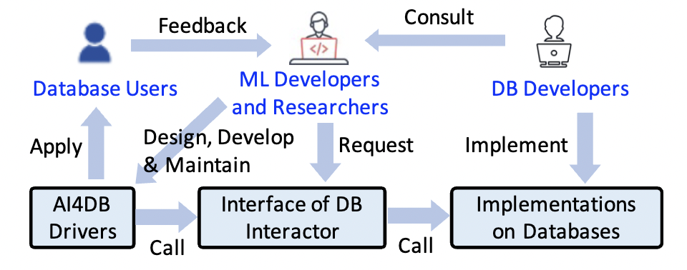
PilotScope: Workflow

Slide 19
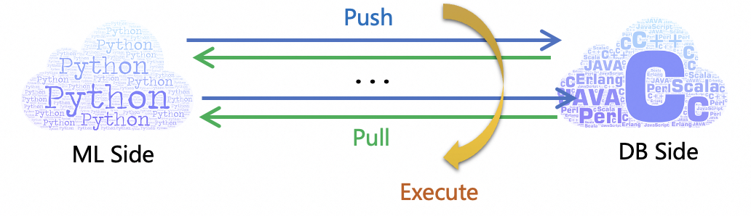
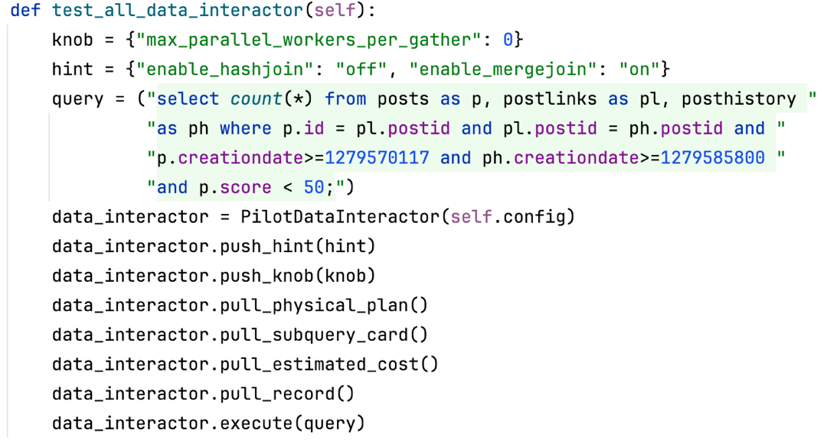
PilotScope: DB Interactors
Flexible APIs
Push: send data to DB
Pull: fetch data from DB
Any combination in a session
Execute: trigger execution
Supported data types
Knob/hint/index
Sub-query/cardinality/cost
Plan/Latency
…

Slide 20
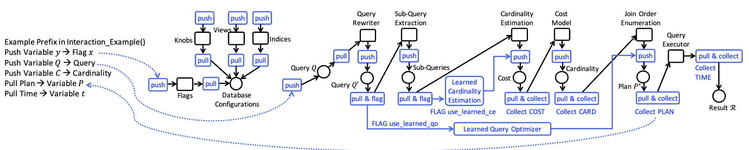
PilotScope: Implementation
APIs in the interface: patches before/after each component
Built-in tools: commands/hooks, …
Examine whether to replace this data
Examine whether to collect this data

Slide 21
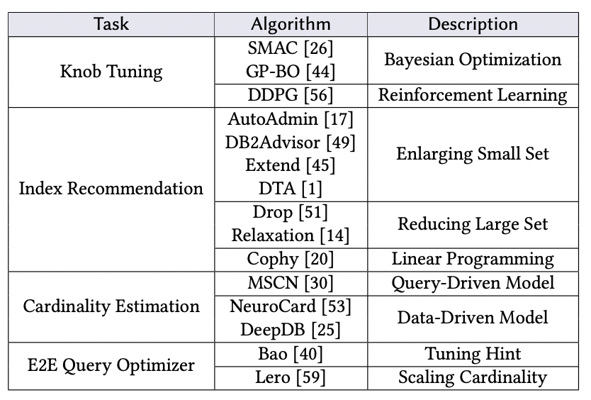
PilotScope: Applications
4 AI4DB tasks, 15+ algorithms on PostgreSQL and Spark
Easy to extend to similar tasks: view advisor, learned cost model…

Slide 22
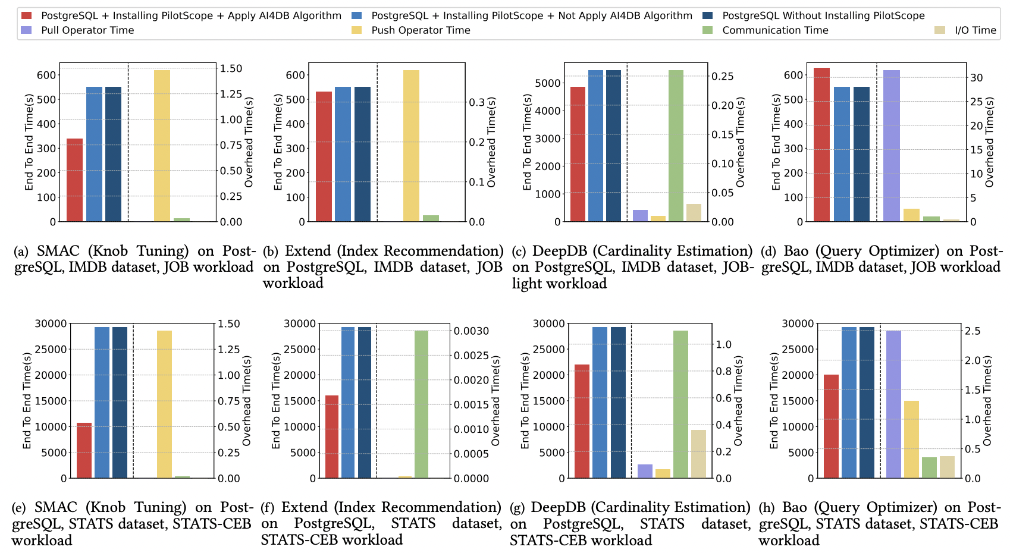
PilotScope: Evaluations
AI4DB algorithms may not always work well
By PilotScope, we know how/when it could perform well/bad → guidelines for future research
Experimental data from [PilotScope: steering databases with ML drivers , VLDB 2024]

Slide 23
PilotScope: Evaluations
Overhead of PilotScope is negligible
Experimental data from [PilotScope: steering databases with ML drivers , VLDB 2024]

Slide 24
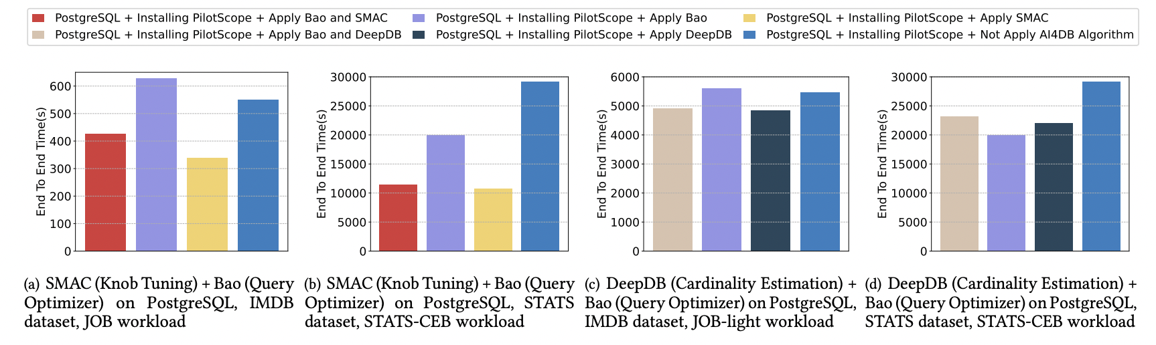
PilotScope: Evaluations
PilotScope could support to deploy and run multiple AI4DB algorithms at the same time
1 + 1 > 2? → not always hold, correlations are complex
A new and interesting topic in AI4DB
Experimental data from [PilotScope: steering databases with ML drivers , VLDB 2024]

Slide 25
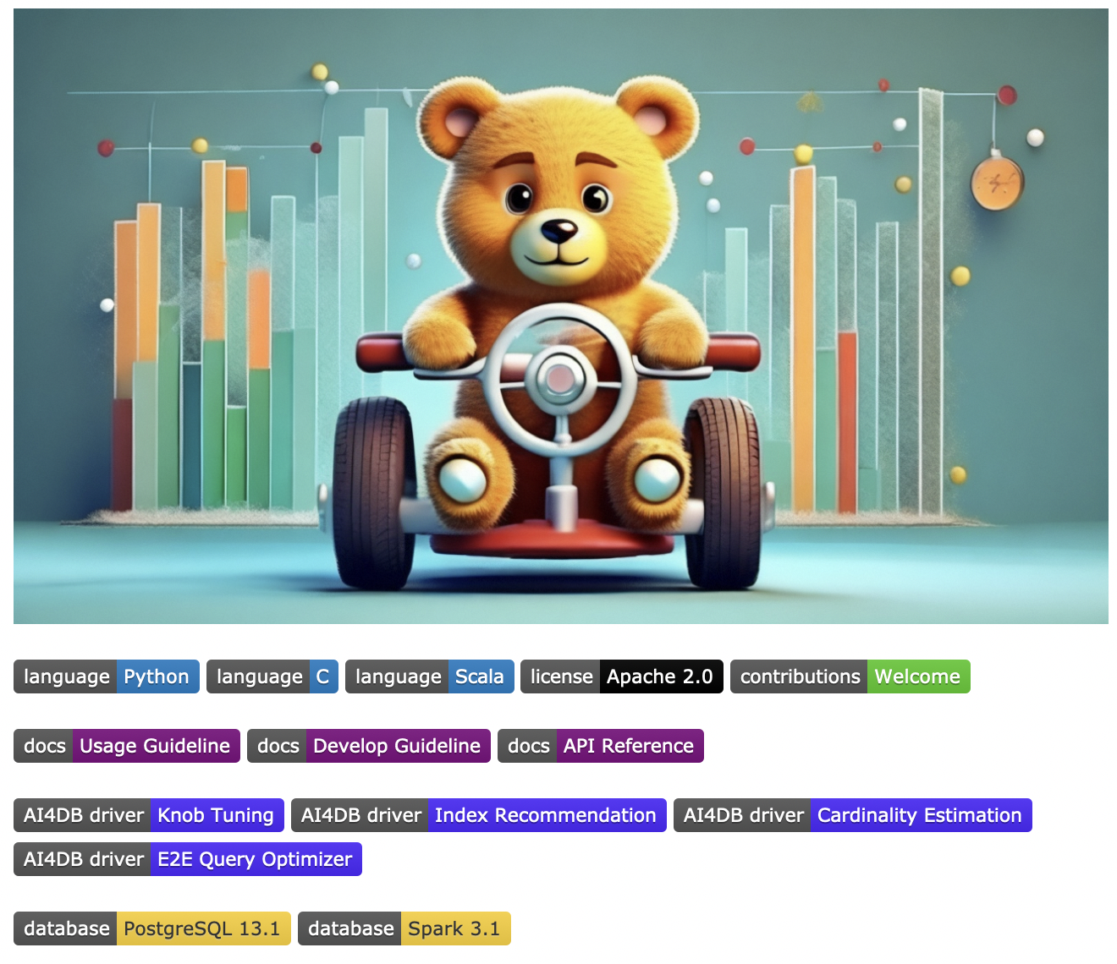

PilotScope: More to Come
Open-Source: https://github.com/alibaba/pilotscope
Welcome for the contributions
to build this community together
Figure generated by Tongyi Wanxiang (https://tongyi.aliyun.com/wanxiang/)

